Slide 1
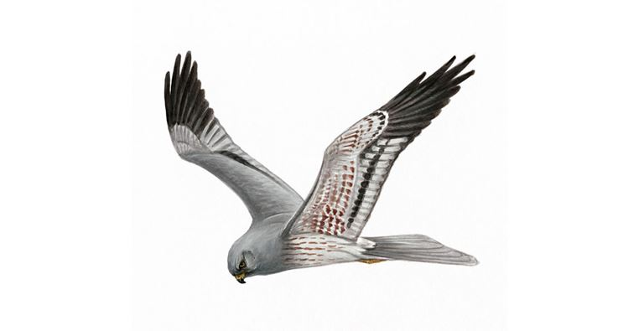
Using open CMR for conservation
French Montagu harriers

Slide 2
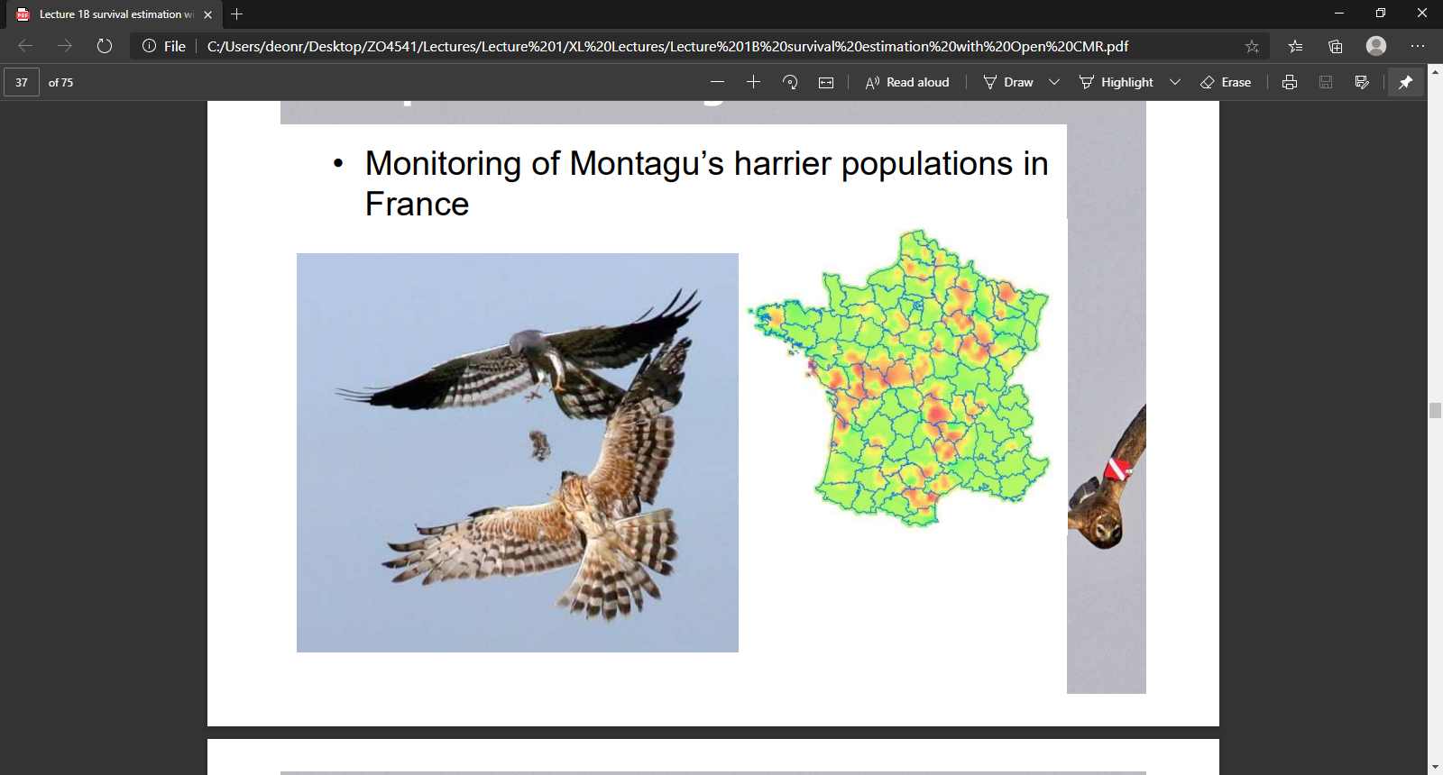
Species of conservation concern

Slide 3
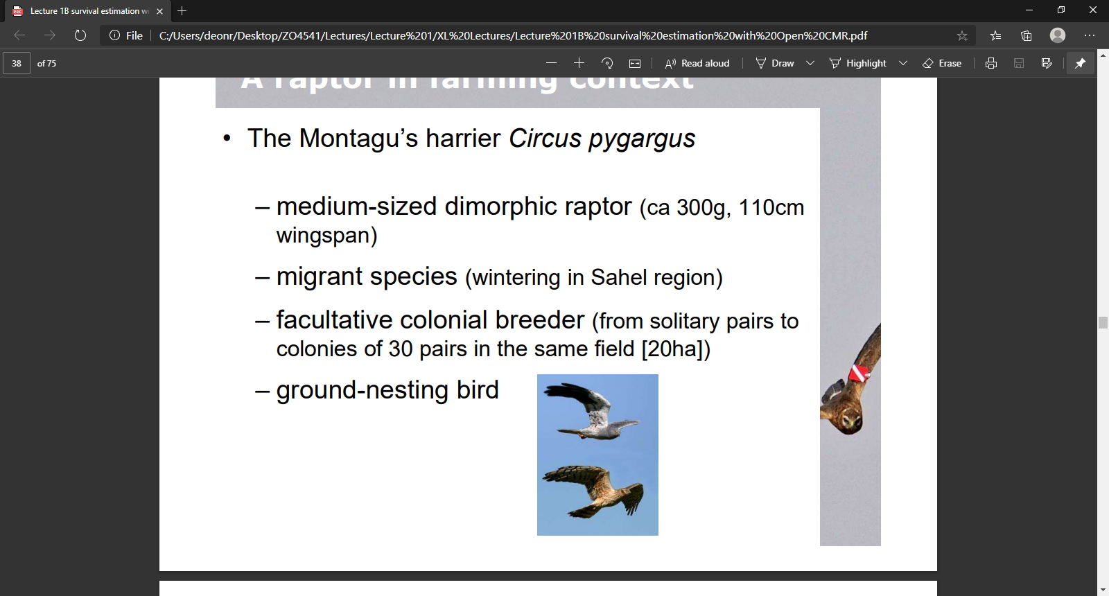
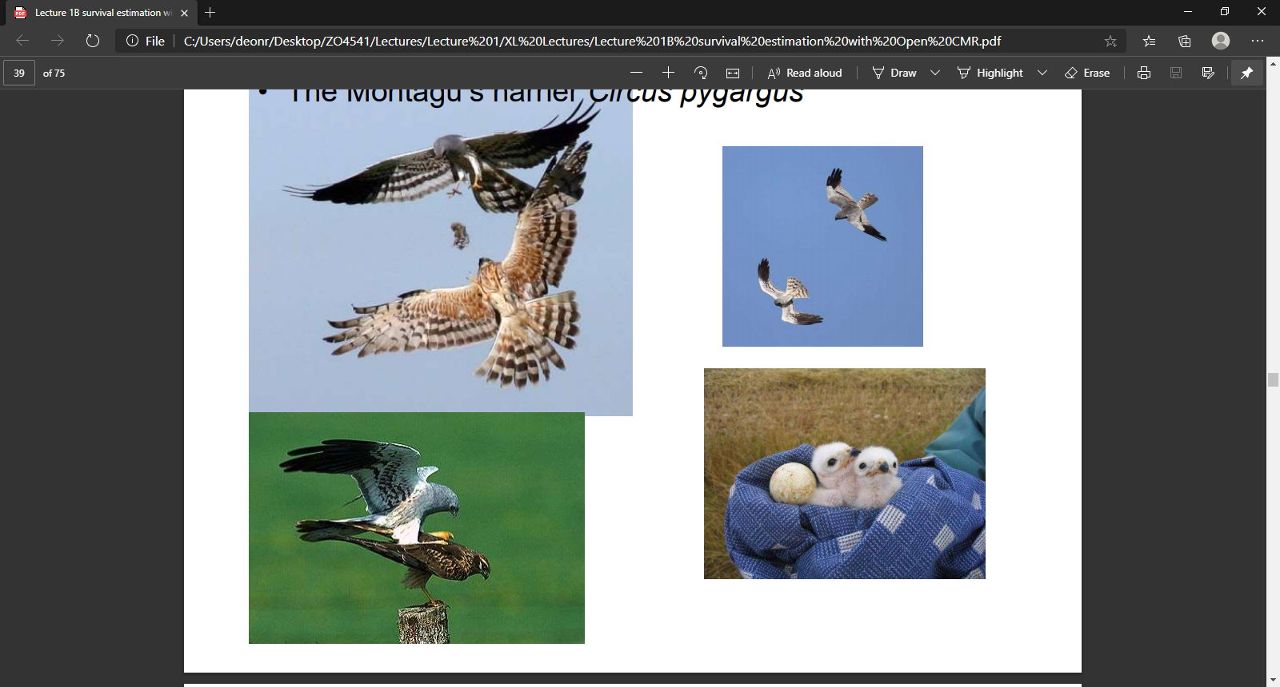
Natural history of Circus pygargus
Medium-sized raptor
Ca. 300 g, 110 cm wingspan
Migrant
Overwinter in Sahel
Sexually dimorphic
Females are larger (340 g)
Facultative colonial breeder
Solitary pairs up to colonies of 30
Lifespan of about 6 years
Annual Φ of ca. 72% in UK
Ground nesting
4-5 eggs

Slide 4
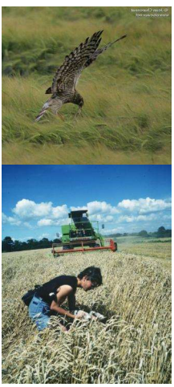
Raptor in farming context
Ground nesting
Often in active fields
At local scale
Every single nest (100%) can be destroyed during harvesting
At a national scale (France)
20-40% of chicks do not fledge before harvesting
The first question for conservation is then, what is the ratio between agricultural and natural breeding habitats?

Slide 5
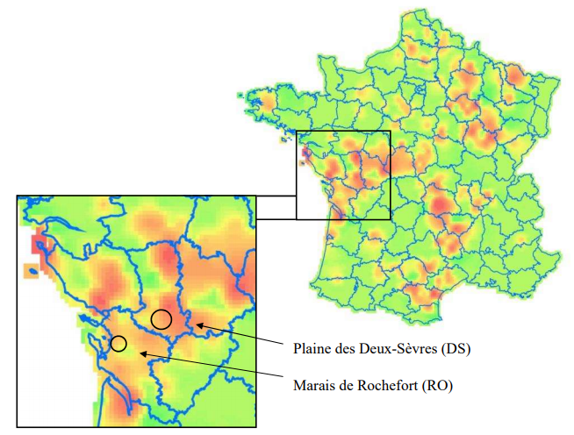
Two areas with focused and intense monitoring
RO mostly marshes DS mostly agricultural fields

Slide 6
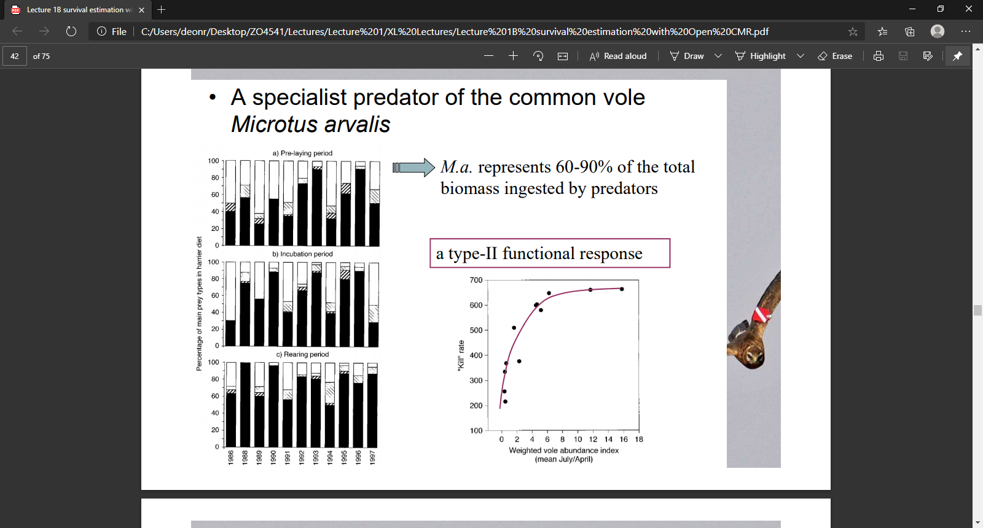
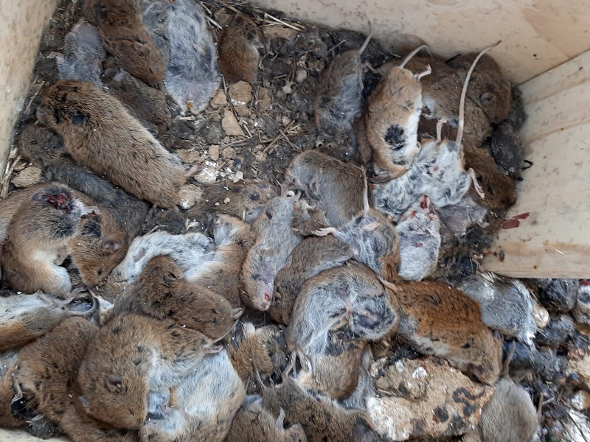
Predator-prey dynamics
Montagu’s are specialist predators of common voles
Voles make up 60-90% of total biomass of Montagu diet
Type-II functional response

Slide 7
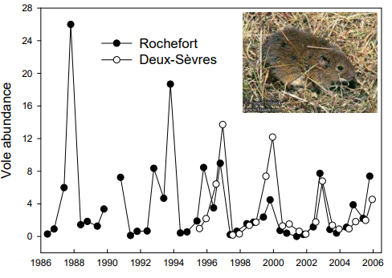
Le French common voles
French voles have cyclicity over a 3 year period
Abundance can vary 100-fold between peak and low phases
Meaning in one year there is more food than you can eat
But in the following, it’s a desert

Slide 8
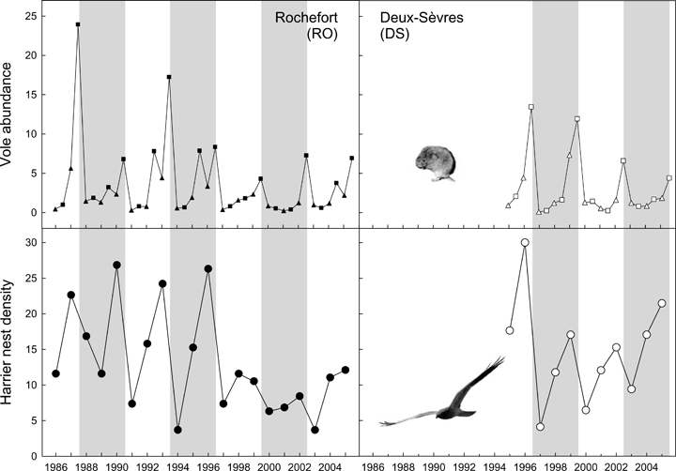
Harriers “track” vole abundance
Montagu abundances vary from year to year (by ca. 50%)
From 4 nests per 100 km²
To 30 nests per 100 km²
Vole abundances vary from year to year (by ca. 120%)
From 1 vole per ha
To > 200 voles per ha
25% of nests in fields
99% of nests in fields

Slide 9
Harriers “track” vole abundance
Management implication?
More natural land for harriers would improve fecundity/fledgling rate.
Options;
Agri-environmental schemes?
Buy farmland?
Colony relocations?
25% of nests in fields
99% of nests in fields

Slide 10
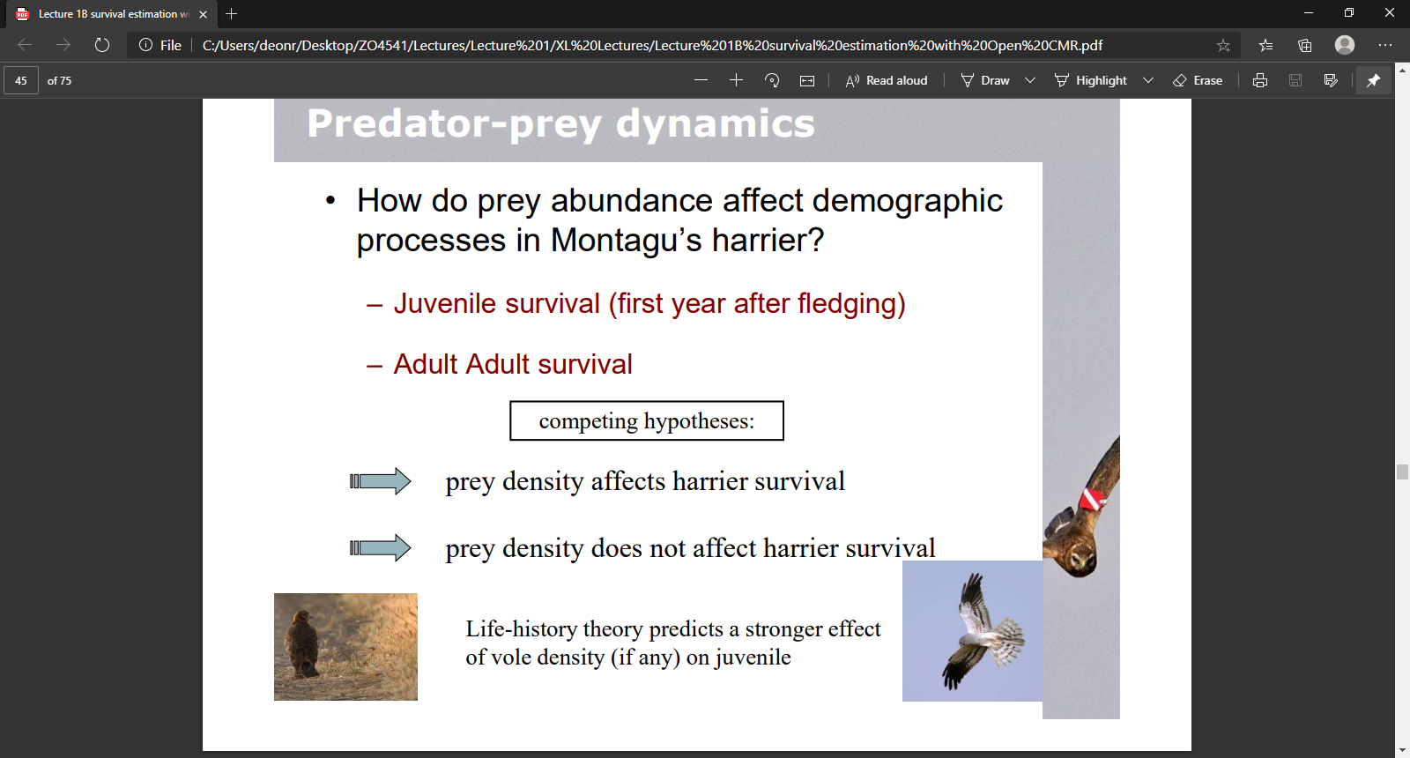
Hypothesis of conservation concern
How do prey abundances affect demographic processes in Montagu’s harriers?
Need to take into account that Montagu’s have 2 stages of life
Juvenile stage (with a juvenile survival rate)
Adult stage (with an adult survival rate)
Competing hypotheses
Prey density affects harrier survival
Prey density affects juvenile and adult survival, but juveniles hit worse
Prey density does not affect harrier survival
Prey density does not affect either juvenile or adult survival

Slide 11
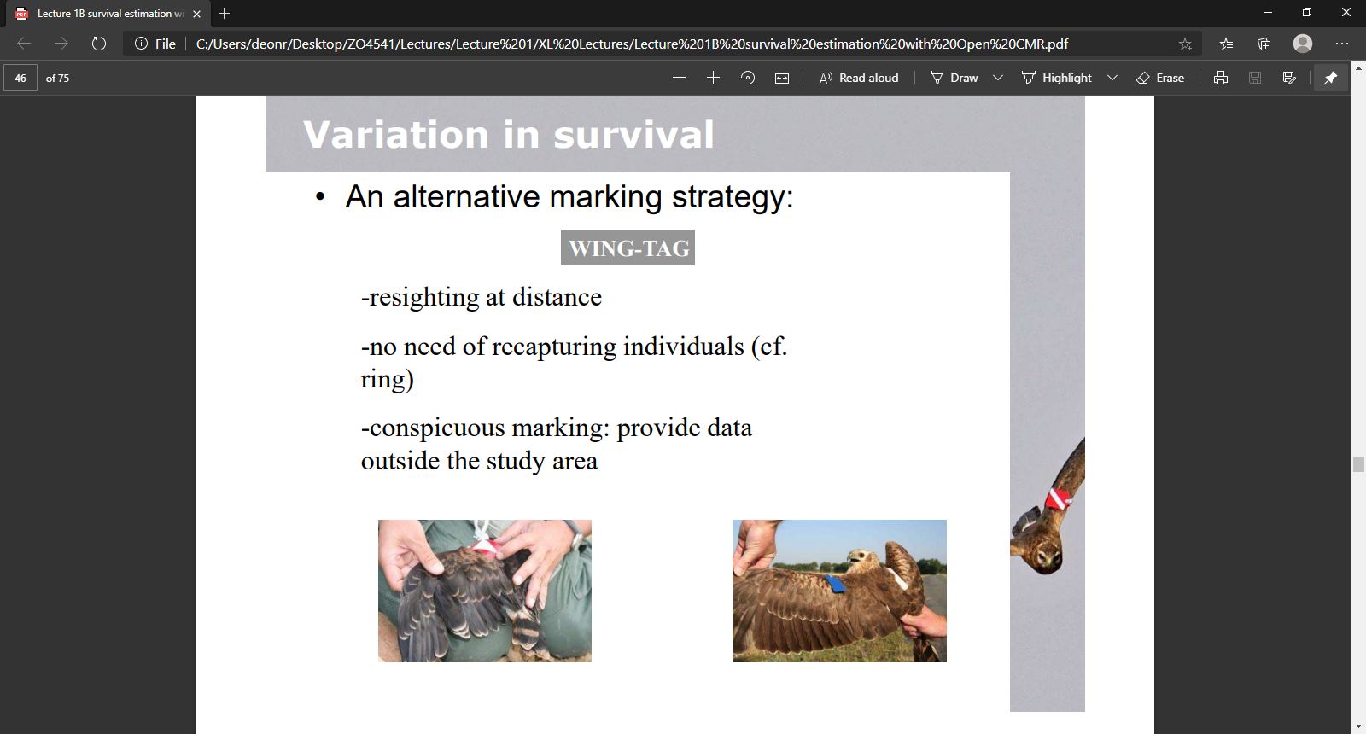
Alternative marking strategy
Capture a harrier once and add wing tags
Which means
No need to physically recapture the animal again
Just spot it through a telescope/binocs
Less stress
Conspicuous marking
Can be spotted and recorded in other countries
Both juveniles and adults are captured
So some are juveniles when first caught, but later become adults

Slide 12
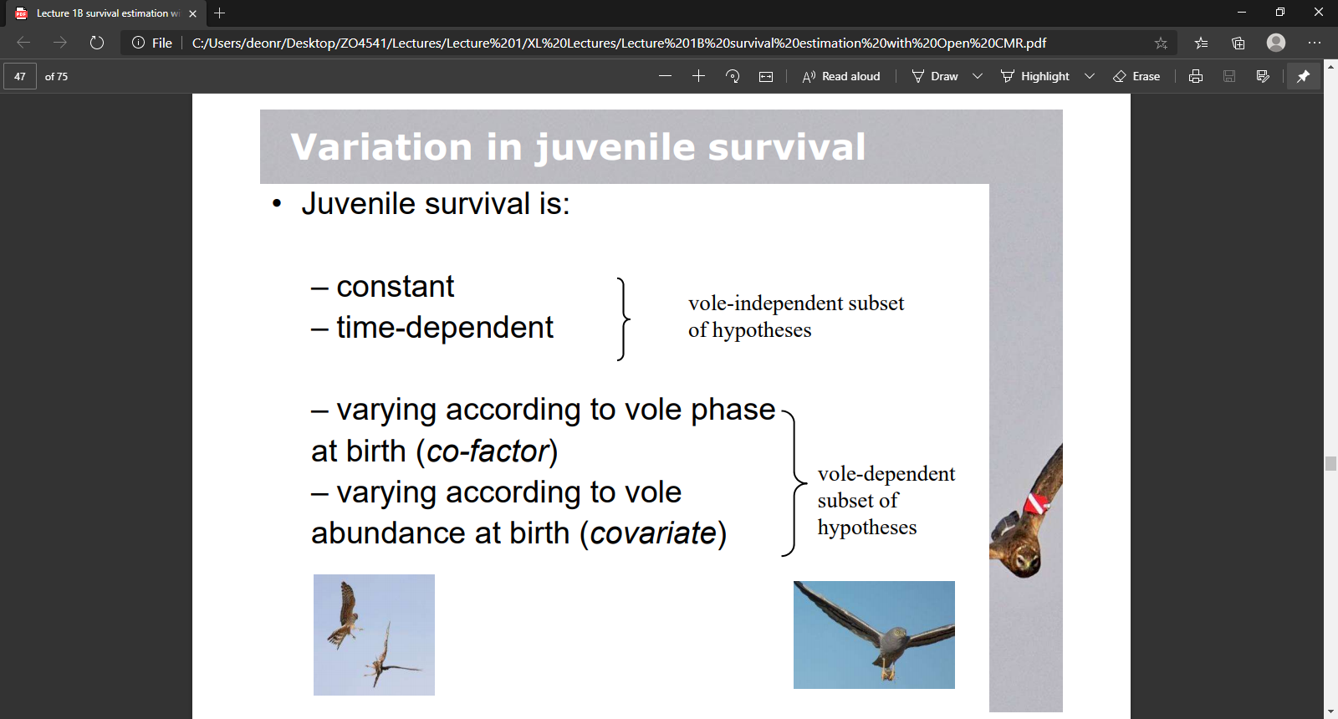
Which factors influence juvenile survival?
Juvenile survival is:
Constant
Time-dependent
Varies with vole phase at birth
Varies with vole abundance at birth
Survival is independent with vole
Survival is dependent with vole

Slide 13

Implementing these models in MARK

Slide 14
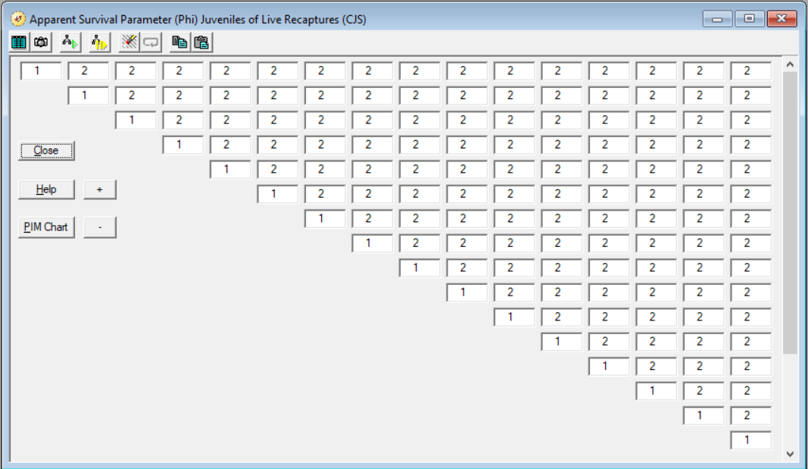
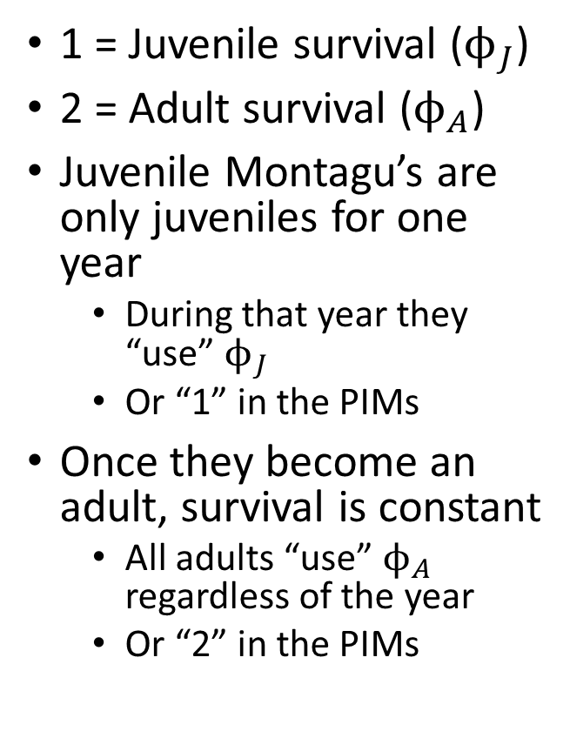
Constant but stage specific survival
1 = Juvenile survival ($ϕ_{J}$)
2 = Adult survival ($ϕ_{A}$)
Juvenile Montagu’s are only juveniles for one year
During that year they “use” $ϕ_{J}$
Or “1” in the PIMs
Once they become an adult, survival is constant
All adults “use” $ϕ_{A}$ regardless of the year
Or “2” in the PIMs

Slide 15
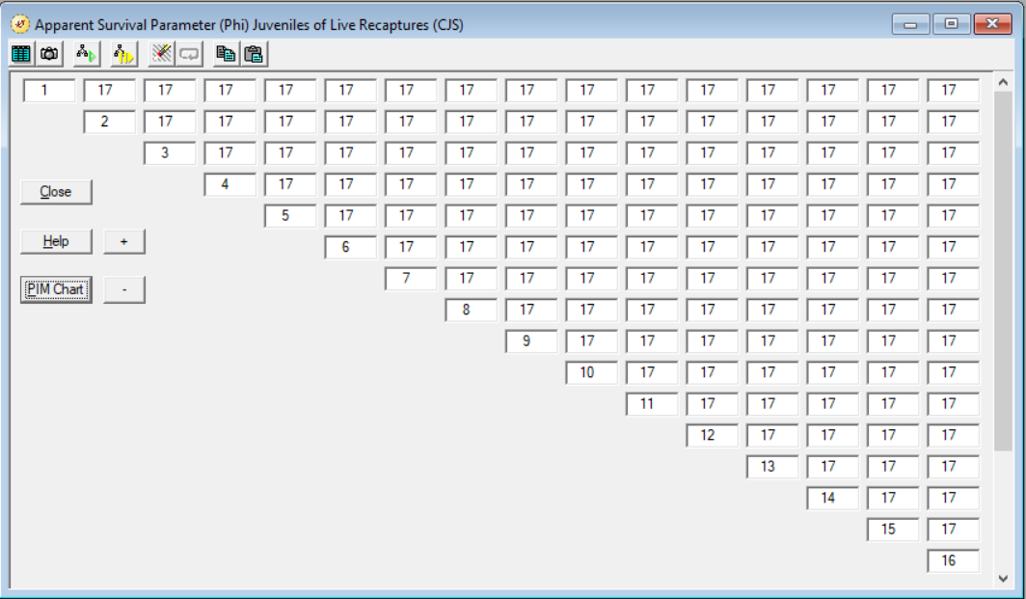
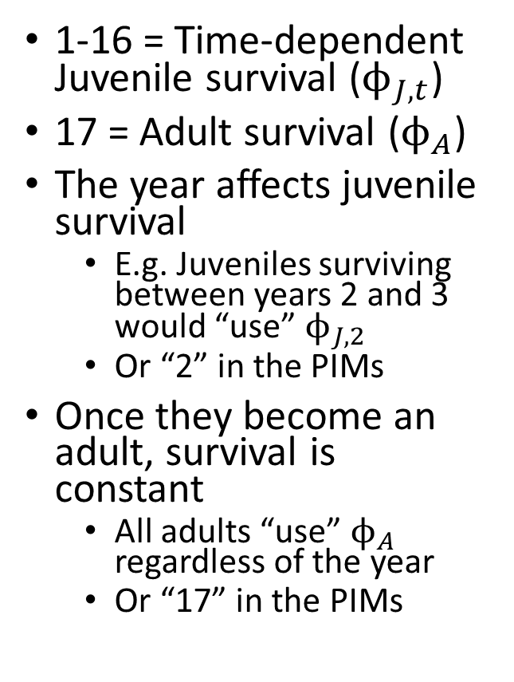
Time dependent juvenile survival
1-16 = Time-dependent Juvenile survival ($ϕ_{J,t}$)
17 = Adult survival ($ϕ_{A}$)
The year affects juvenile survival
E.g. Juveniles surviving between years 2 and 3 would “use” $ϕ_{J,2}$
Or “2” in the PIMs
Once they become an adult, survival is constant
All adults “use” $ϕ_{A}$ regardless of the year
Or “17” in the PIMs

Slide 16

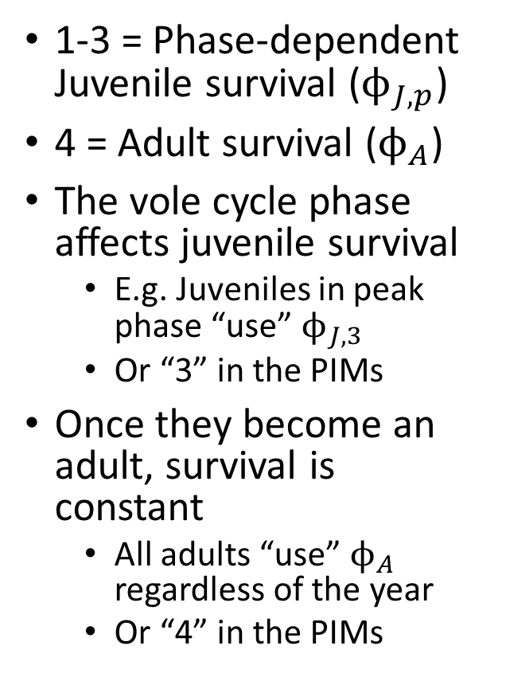
Vole phase dependent juvenile survival
1-3 = Phase-dependent Juvenile survival ($ϕ_{J,p}$)
4 = Adult survival ($ϕ_{A}$)
The vole cycle phase affects juvenile survival
E.g. Juveniles in peak phase “use” $ϕ_{J,3}$
Or “3” in the PIMs
Once they become an adult, survival is constant
All adults “use” $ϕ_{A}$ regardless of the year
Or “4” in the PIMs
Vole cycle has 3 phases 1- Low for Juve
2- Mid for Juve
3- Peak for Juve

Slide 17
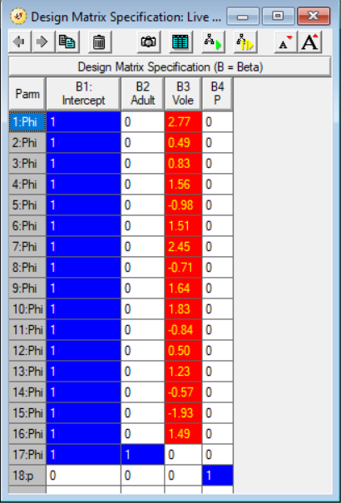
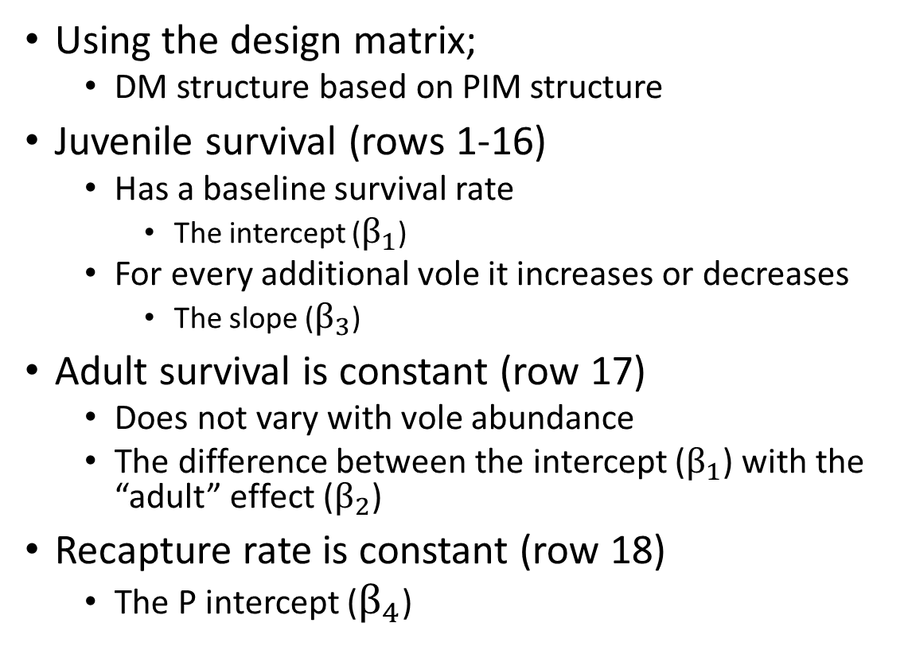
Vole abundance dependent juvenile survival
Using the design matrix;
DM structure based on PIM structure
Juvenile survival (rows 1-16)
Has a baseline survival rate
The intercept ($β_{1}$)
For every additional vole it increases or decreases
The slope ($β_{3}$)
Adult survival is constant (row 17)
Does not vary with vole abundance
The difference between the intercept ($β_{1}$) with the “adult” effect ($β_{2}$)
Recapture rate is constant (row 18)
The P intercept ($β_{4}$)

Slide 18
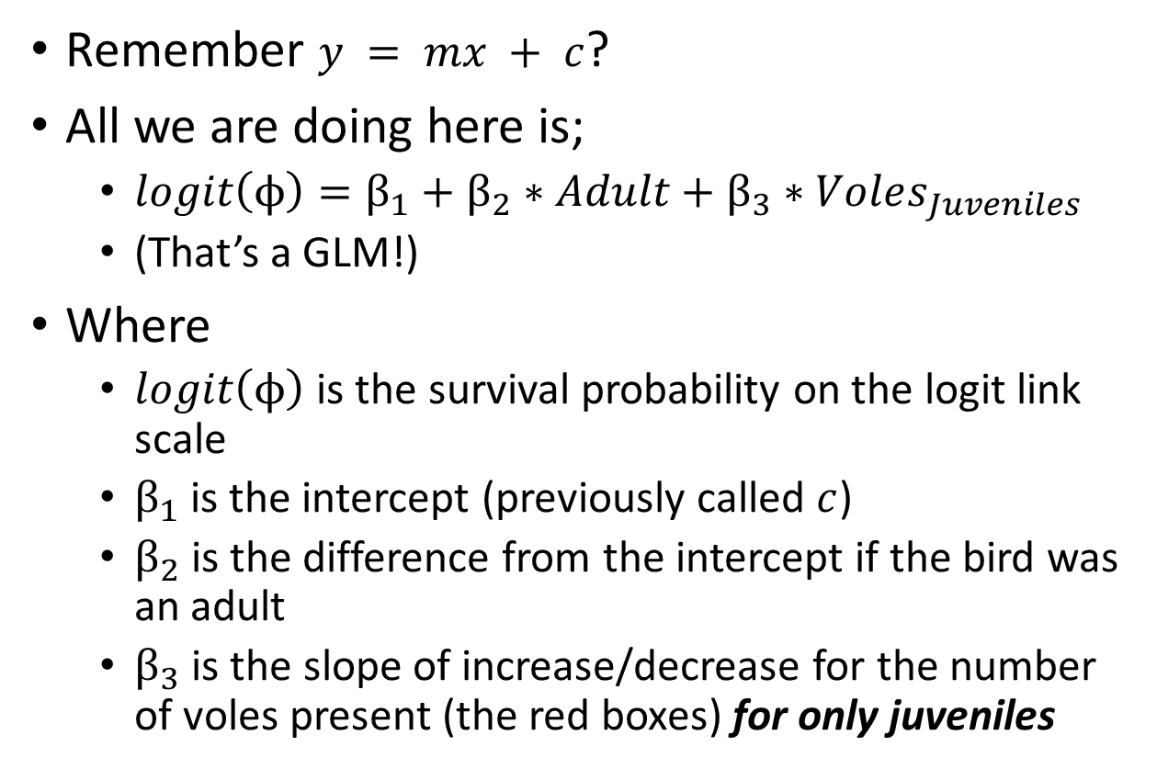
Vole abundance dependent juvenile survival
Remember $y = mx + c$?
All we are doing here is;
$logit\left(ϕ\right)=β_{1}+β_{2}∗Adult+β_{3}∗Voles_{Juveniles}$
(That’s a GLM!)
Where
$logit\left(ϕ\right)$ is the survival probability on the logit link scale
$β_{1}$is the intercept (previously called $c$)
$β_{2}$is the difference from the intercept if the bird was an adult
$β_{3}$ is the slope of increase/decrease for the number of voles present (the red boxes) for only juveniles

Slide 19
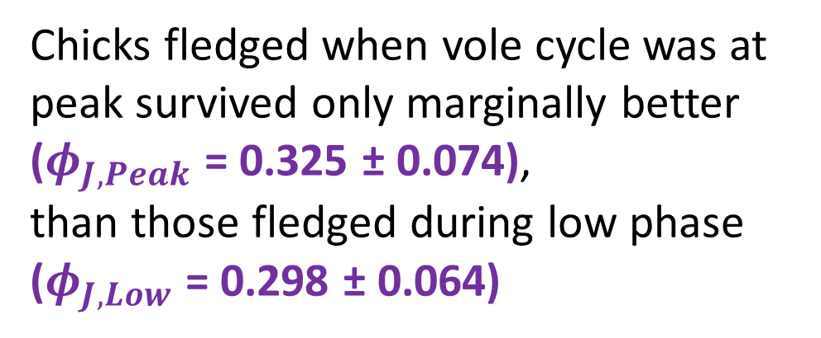
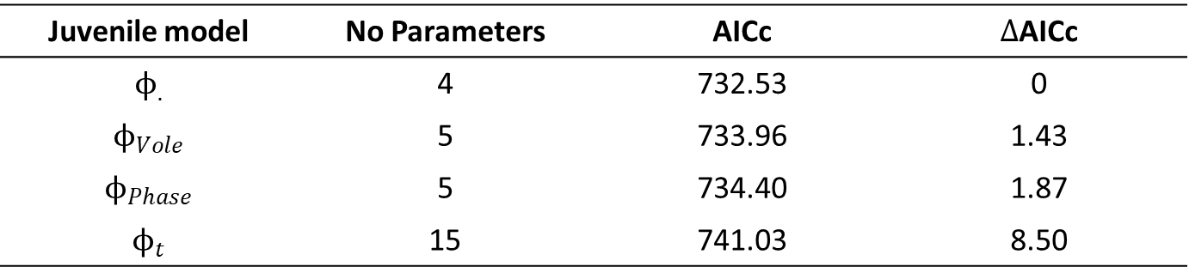
What caused variation in juvenile survival?
Juvenile model | No Parameters | AICc | $Δ$AICc
$$ϕ_{.}$$ | 4 | 732.53 | 0
$$ϕ_{Vole}$$ | 5 | 733.96 | 1.43
$$ϕ_{Phase}$$ | 5 | 734.40 | 1.87
$$ϕ_{t}$$ | 15 | 741.03 | 8.50
Chicks fledged when vole cycle was at peak survived only marginally better ($φ_{J,Peak}$ = 0.325 ± 0.074), than those fledged during low phase ($φ_{J,Low}$ = 0.298 ± 0.064)
Keep this distinction in mind for your advocacy presentations. Statistical importance does not mean biological importance
So statistical difference, but probably not a biologically meaningful one

Slide 20
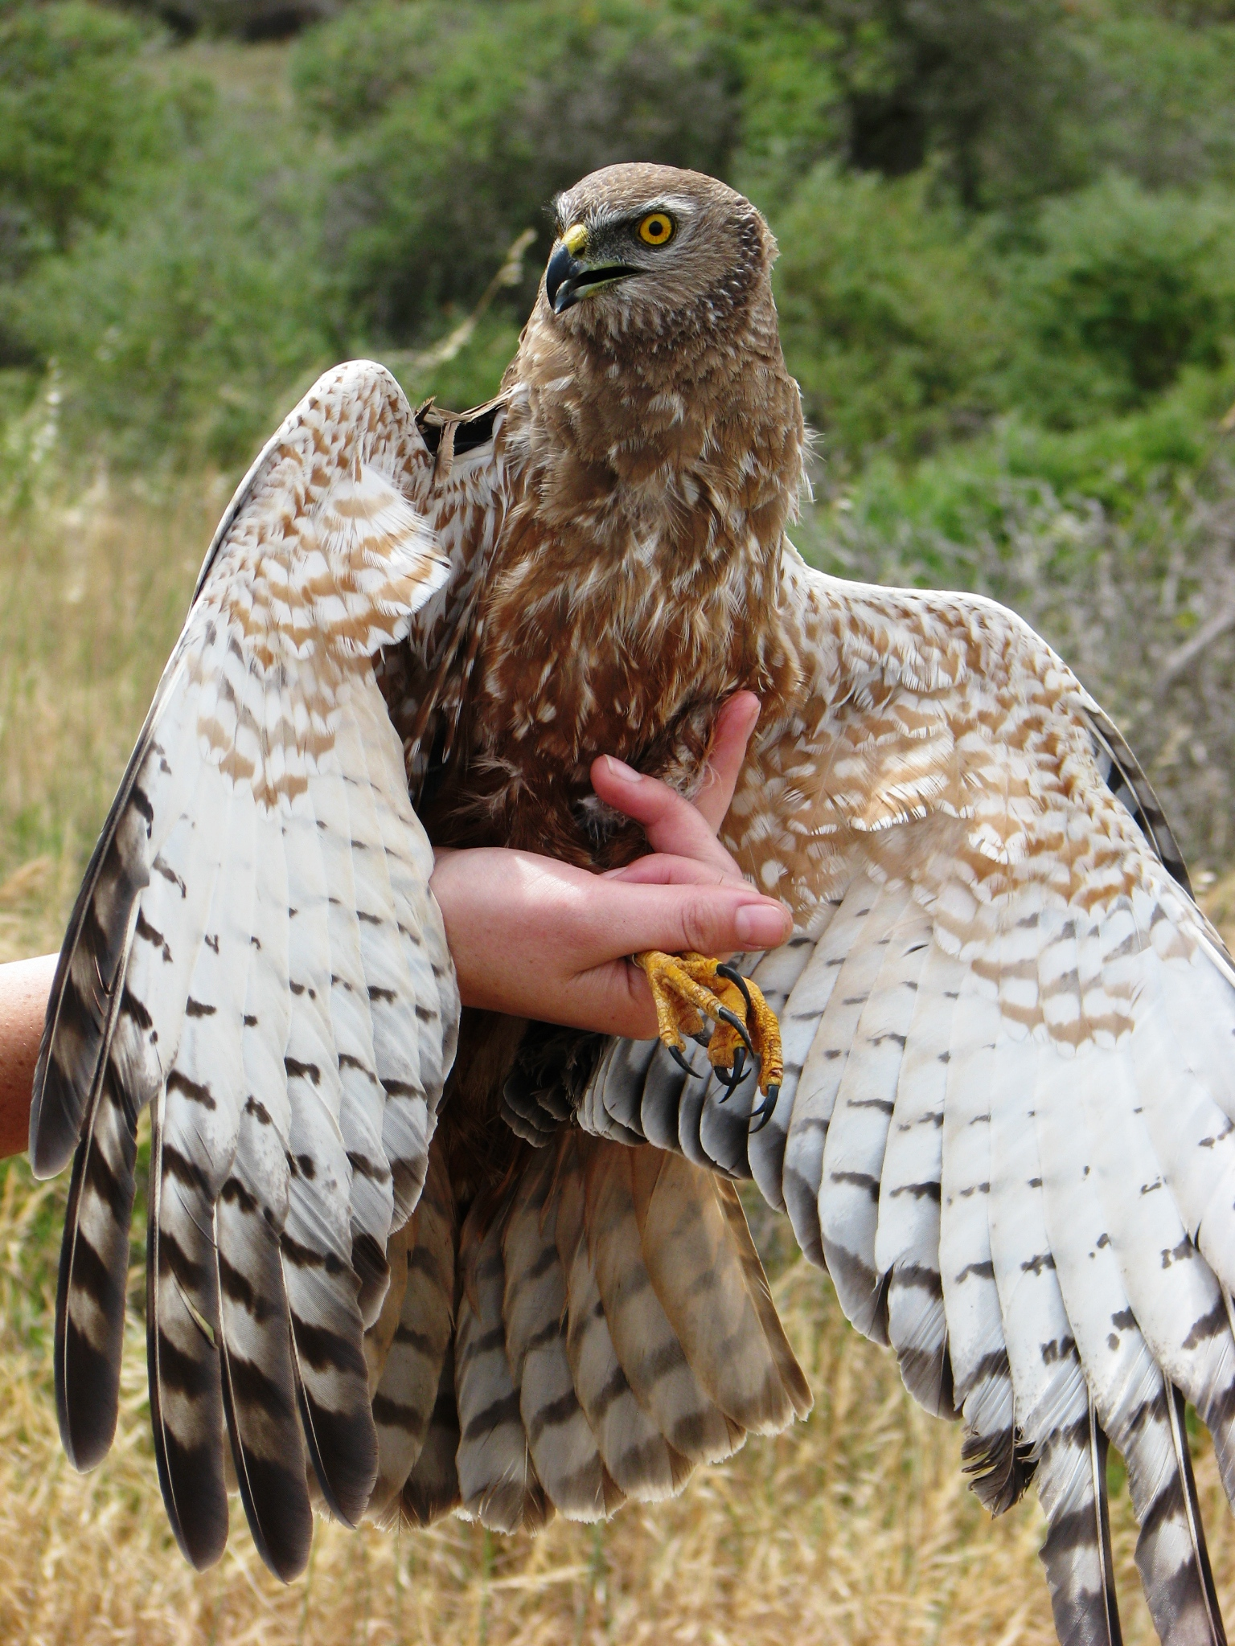
Accounting for variation in adult survival

Slide 21
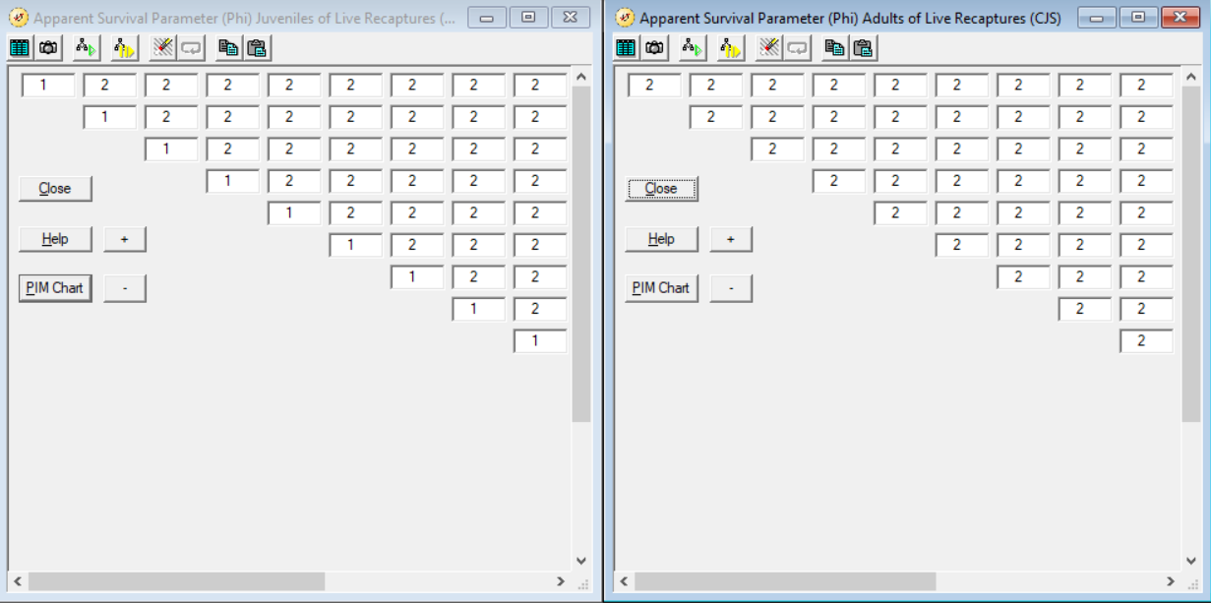
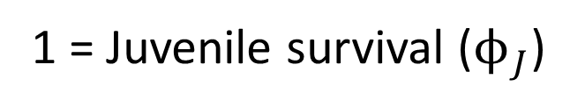
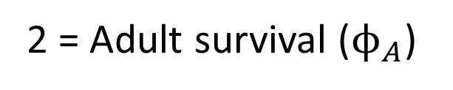
Constant but stage specific survival
1 = Juvenile survival ($ϕ_{J}$)
2 = Adult survival ($ϕ_{A}$)

Slide 22

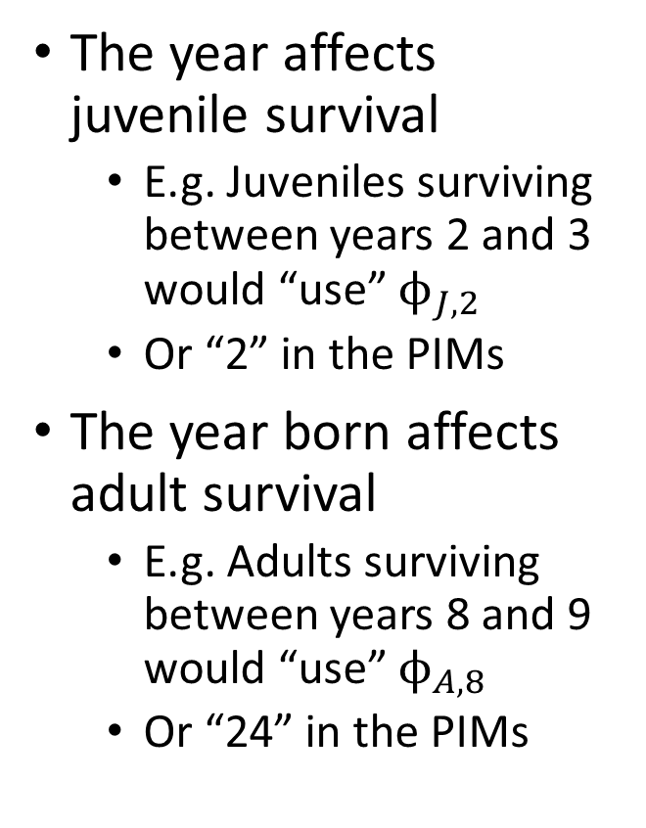
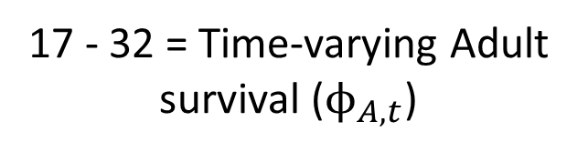
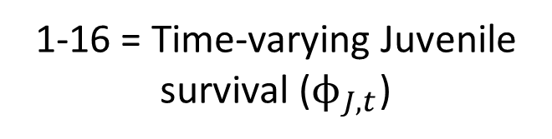
Time dependent juvenile survival
The year affects juvenile survival
E.g. Juveniles surviving between years 2 and 3 would “use” $ϕ_{J,2}$
Or “2” in the PIMs
The year born affects adult survival
E.g. Adults surviving between years 8 and 9 would “use” $ϕ_{A,8}$
Or “24” in the PIMs
1-16 = Time-varying Juvenile survival ($ϕ_{J,t}$)
17 - 32 = Time-varying Adult survival ($ϕ_{A,t}$)

Slide 23
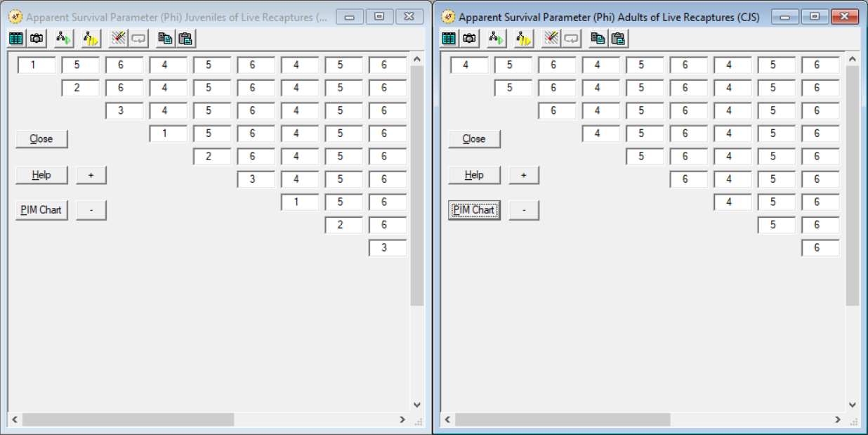
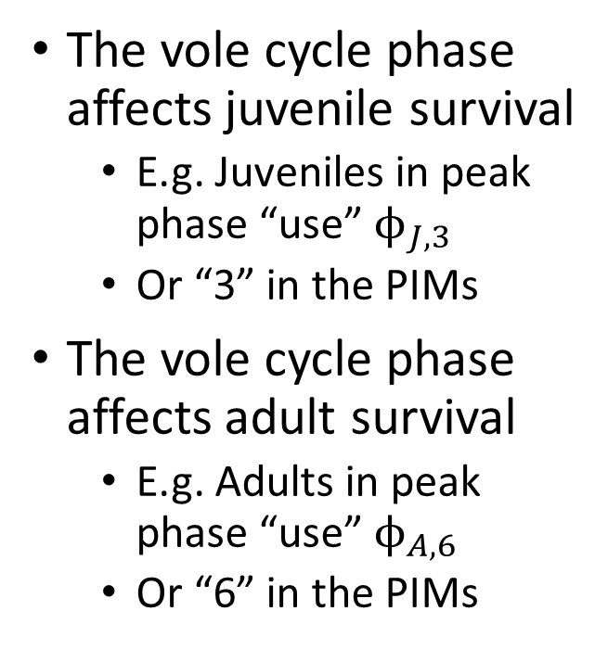
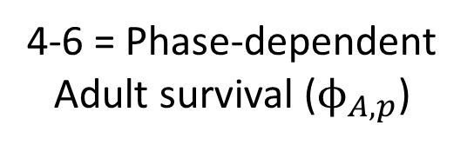
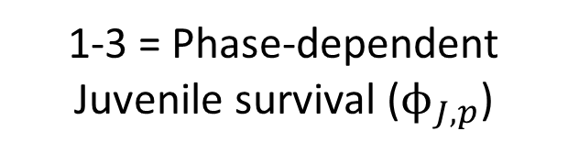
Vole phase dependent juvenile survival
1-3 = Phase-dependent Juvenile survival ($ϕ_{J,p}$)
4-6 = Phase-dependent Adult survival ($ϕ_{A,p}$)
The vole cycle phase affects juvenile survival
E.g. Juveniles in peak phase “use” $ϕ_{J,3}$
Or “3” in the PIMs
The vole cycle phase affects adult survival
E.g. Adults in peak phase “use” $ϕ_{A,6}$
Or “6” in the PIMs
Vole cycle has 3 phases 1- Low for Juve 4 - Low for Adults
2- Mid for Juve 5 - Mid for Adults
3- Peak for Juve 6 - Peak for Adults

Slide 24
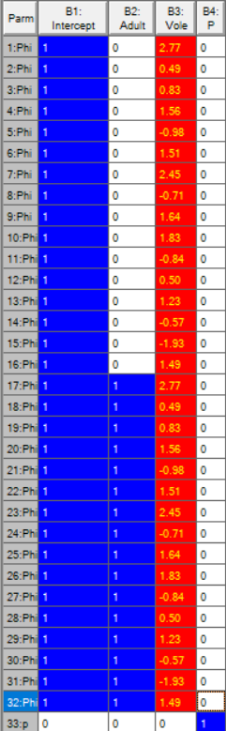
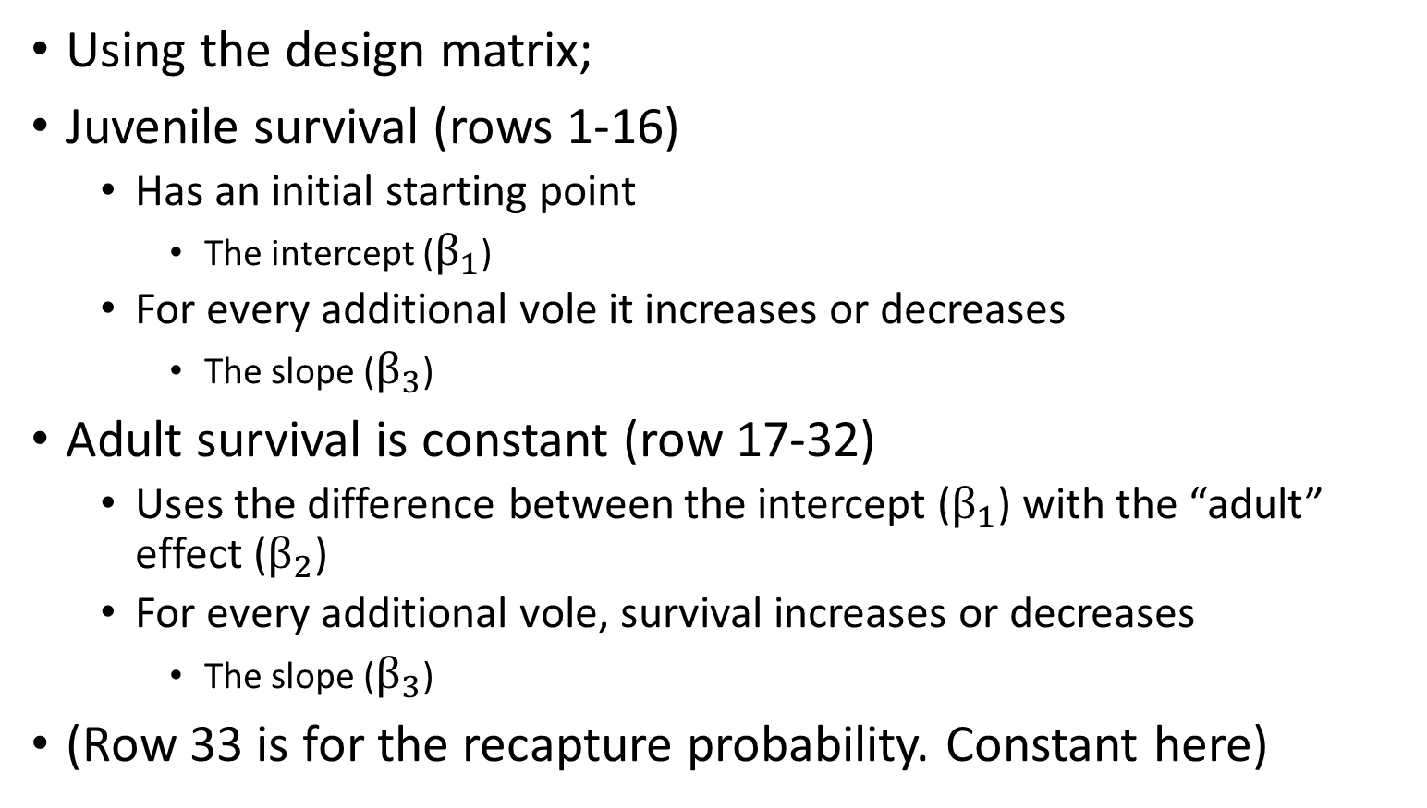
Stage + Vole abundance survival
Using the design matrix;
Juvenile survival (rows 1-16)
Has an initial starting point
The intercept ($β_{1}$)
For every additional vole it increases or decreases
The slope ($β_{3}$)
Adult survival is constant (row 17-32)
Uses the difference between the intercept ($β_{1}$) with the “adult” effect ($β_{2}$)
For every additional vole, survival increases or decreases
The slope ($β_{3}$)
(Row 33 is for the recapture probability. Constant here)

Slide 25
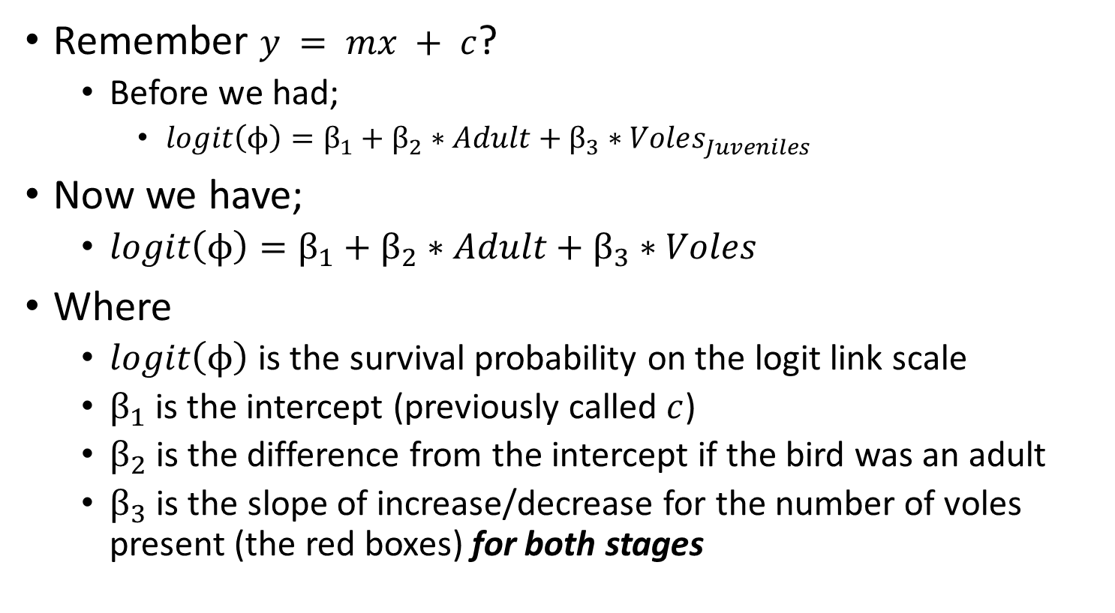
Stage + Vole abundance survival
Remember $y = mx + c$?
Before we had;
$logit\left(ϕ\right)=β_{1}+β_{2}∗Adult+β_{3}∗Voles_{Juveniles}$
Now we have;
$logit\left(ϕ\right)=β_{1}+β_{2}∗Adult+β_{3}∗Voles$
Where
$logit\left(ϕ\right)$ is the survival probability on the logit link scale
$β_{1}$is the intercept (previously called $c$)
$β_{2}$is the difference from the intercept if the bird was an adult
$β_{3}$ is the slope of increase/decrease for the number of voles present (the red boxes) for both stages

Slide 26
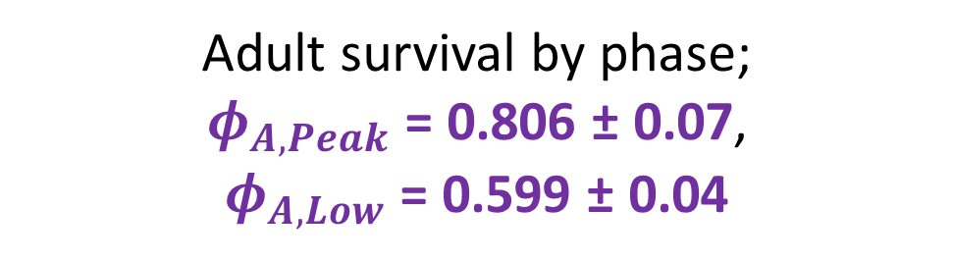
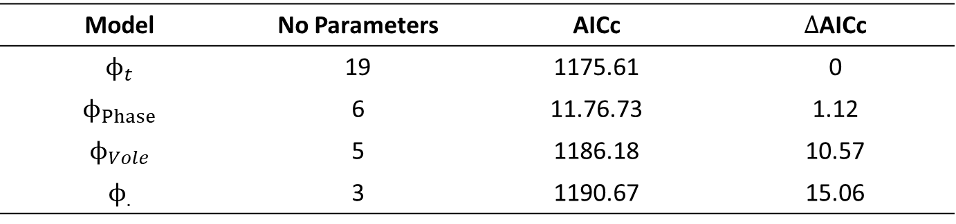
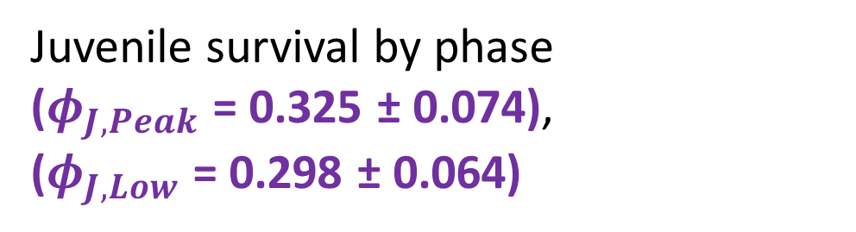
What caused variation in adult survival?
Model | No Parameters | AICc | $Δ$AICc
$$ϕ_{t}$$ | 19 | 1175.61 | 0
$$ϕ_{Phase}$$ | 6 | 11.76.73 | 1.12
$$ϕ_{Vole}$$ | 5 | 1186.18 | 10.57
$$ϕ_{.}$$ | 3 | 1190.67 | 15.06
Adult survival by phase; $φ_{A,Peak}$ = 0.806 ± 0.07, $φ_{A,Low}$ = 0.599 ± 0.04
Juvenile survival by phase ($φ_{J,Peak}$ = 0.325 ± 0.074), ($φ_{J,Low}$ = 0.298 ± 0.064)
Are these differences enough to impact the population dynamics?

Slide 27
What’s the deal with French Montagu’s?
Statistical results;
Juveniles unaffected by vole cycle phase
Adults much more affected by vole cycle phase
Biological results;
Harder to provide food for both offspring and yourself
Implies adult harriers “sacrifice” their own survival rate to provide for young
When prey plentiful, adult survival higher
Conservation implications;
Adult supplementary feeding during low vole years?
Feed them in natural habitats to discourage nesting in farms?

